Slide 1
A Tour of HepSim From a User’s Perspective
David Blyth - Postdoc - ANL (HEP)

Slide 2
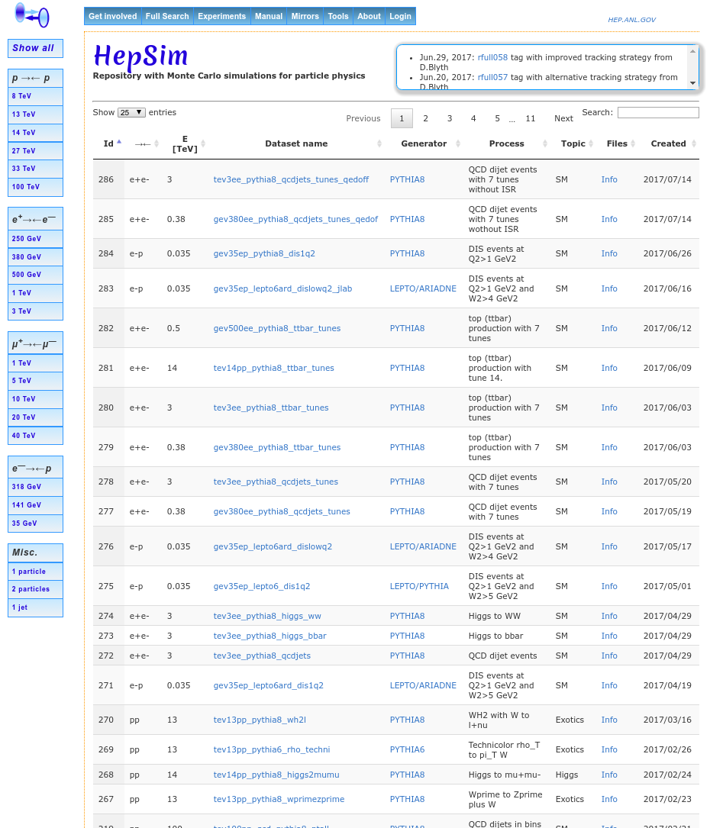
What is HepSim?
A simple but powerful tool for building a “Repository with MC simulations for particle physics”
Consists of a web interface and command-line tools
Already contains ~2 Billion events
LO+PS, NLO, and NLO+PS
Environment to study detector effects with fast and full simulations
Platform that continues to evolve
NOT a storage service
Files are hosted where convenient, and linked to by HepSim

Slide 3
Why HepSim?
Began at Snowmass 2013
Open access
No authentication for use of sample sets
Grab samples with hs-toolkit, wget, curl, etc… your choice!
Preservation and publication of MC samples and simulated data
Cache for iterative experiment design process
Comparison with experimental data
Recreated figure originally by
W. Armstrong

Slide 4
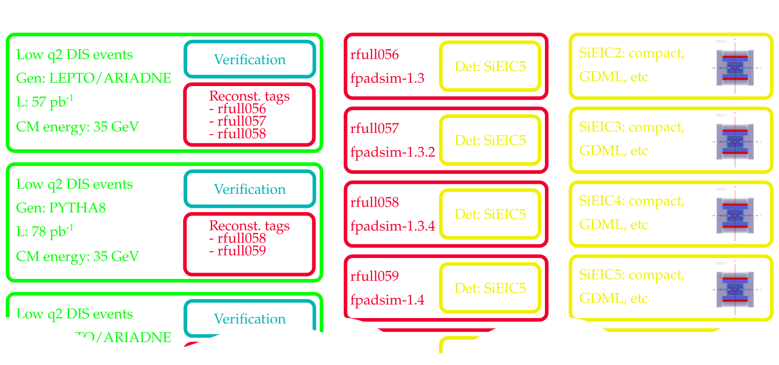
Logical organization of HepSim

Slide 5
Web Interface

Slide 6
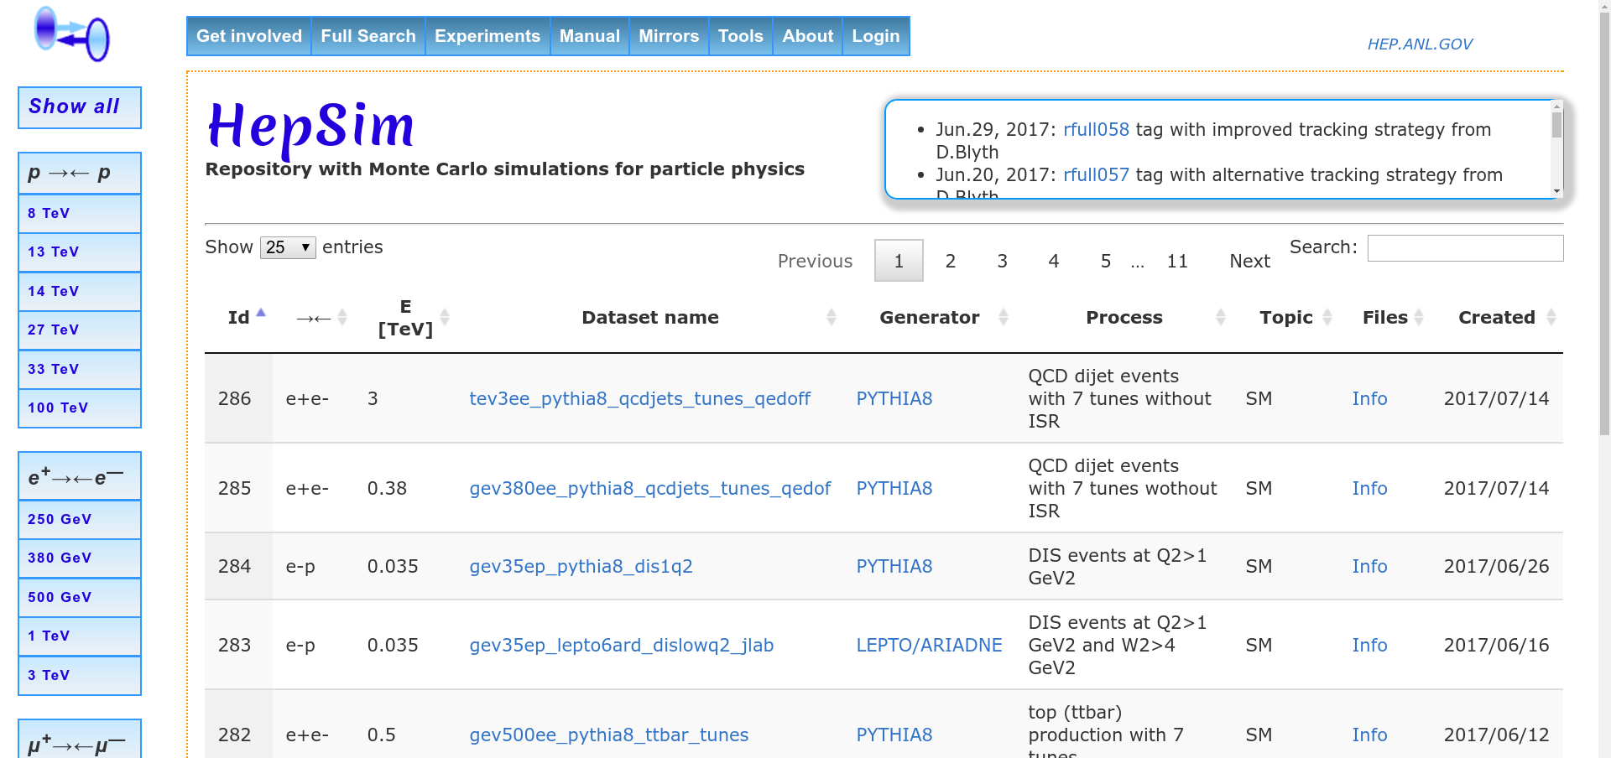
Web Interface - Truth Level Navigation

Slide 7
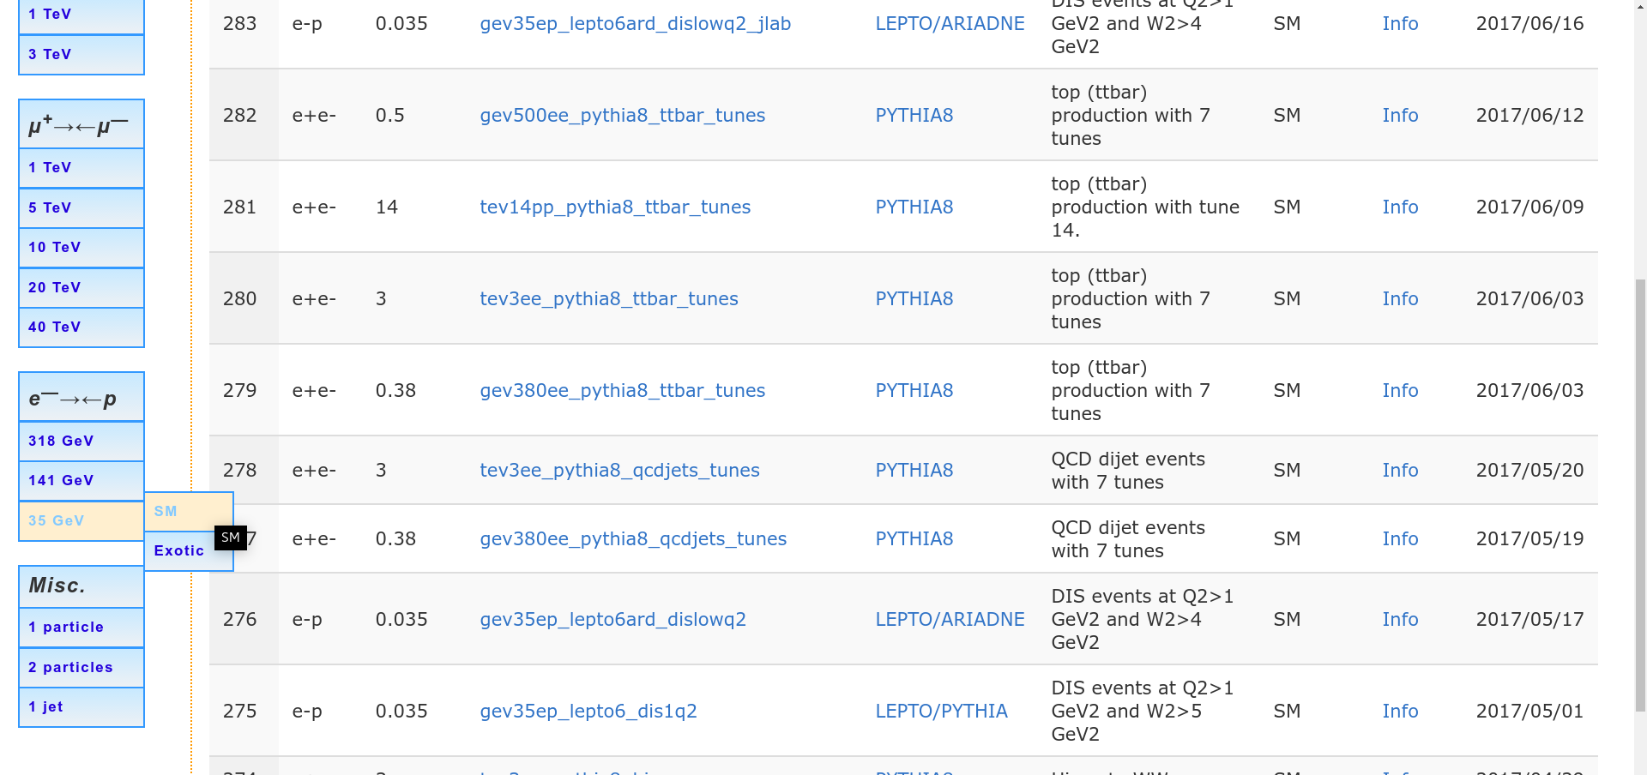
Select by beam species, CM energy, and
topic (SM, Exotic, etc)
Web Interface - Truth Level Navigation

Slide 8
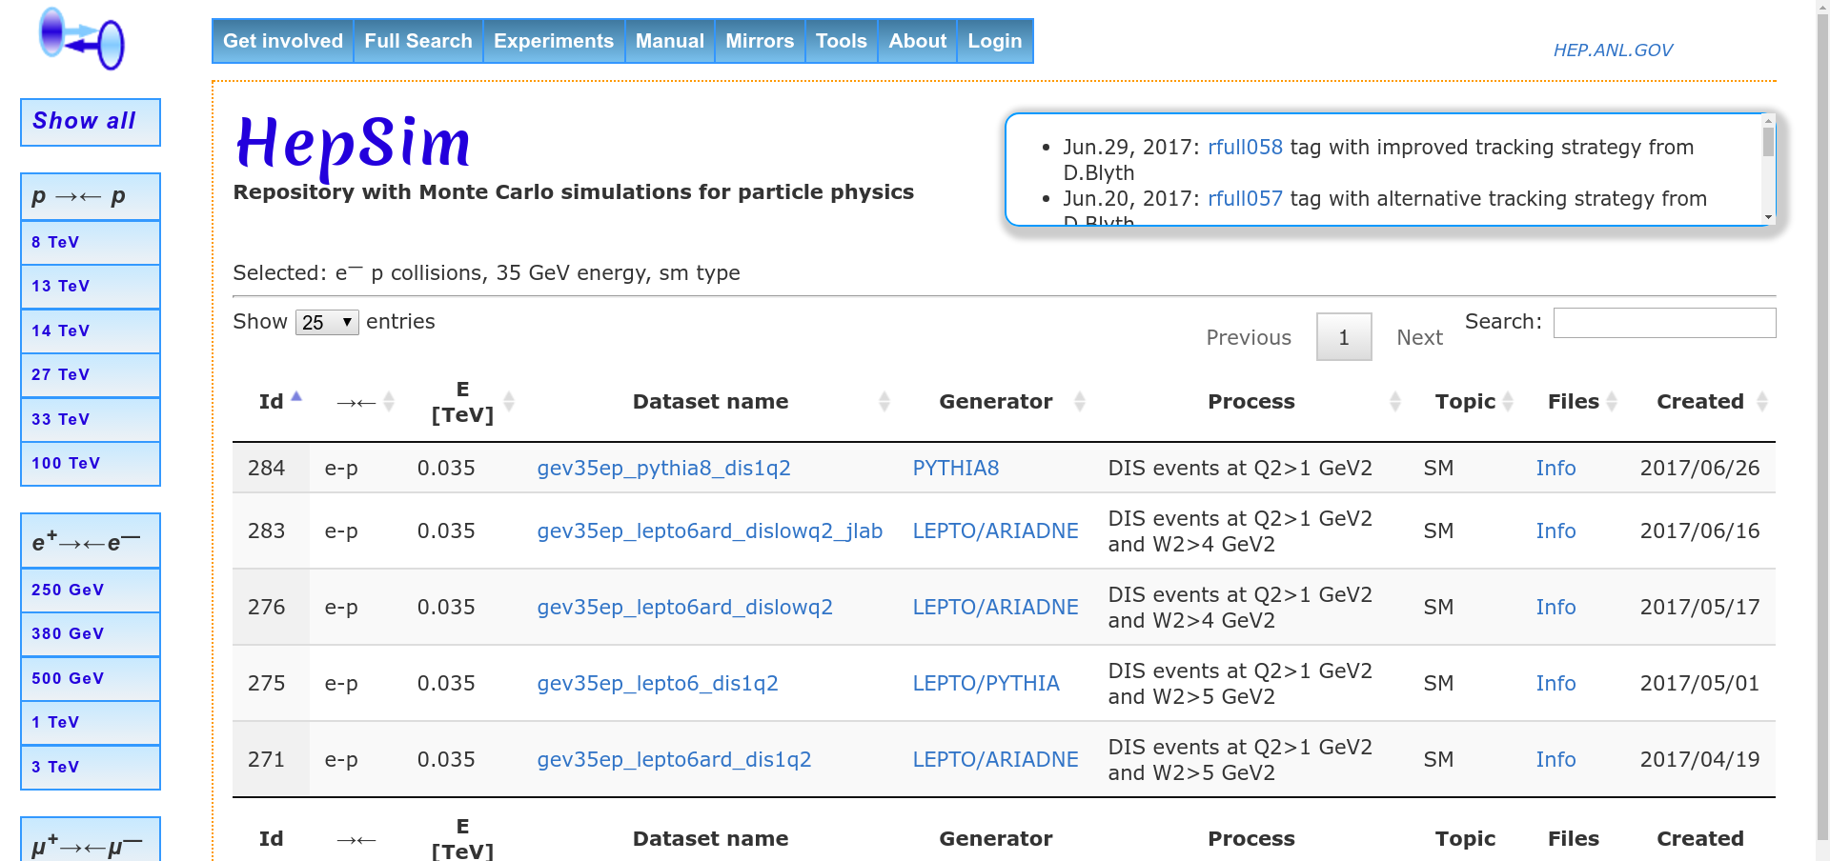
Choose dataset based on generator and process descriptions
Then click on data set name to look at more closely
Web Interface - Truth Level Navigation

Slide 9
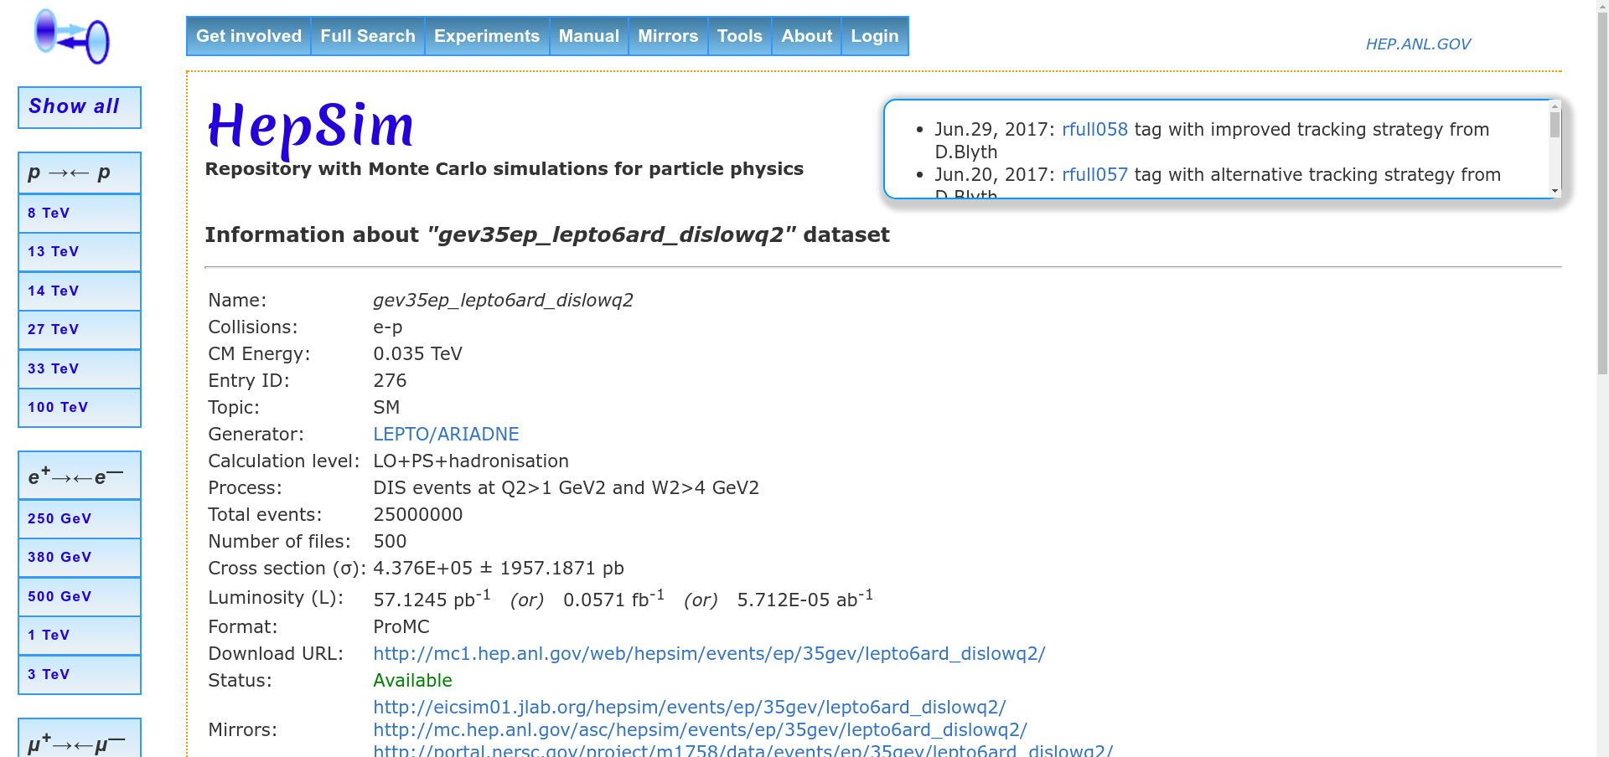
This brings up information page for dataset. Starting with basic parameters, integrated luminosity, and a link to the download page
Web Interface - Truth Level Navigation

Slide 10
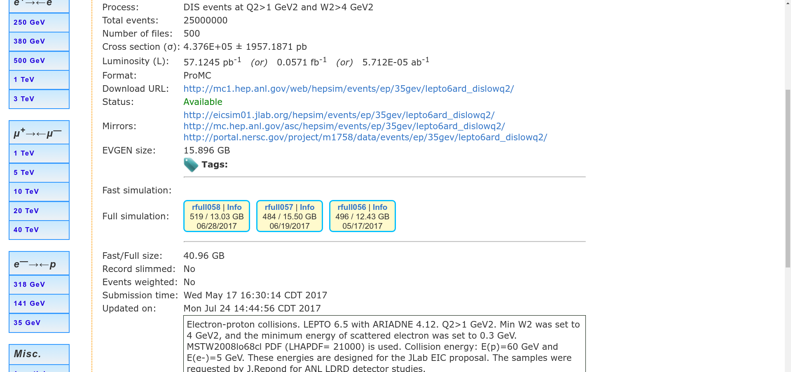
Simulation tags
Web Interface - Truth Level Navigation

Slide 11
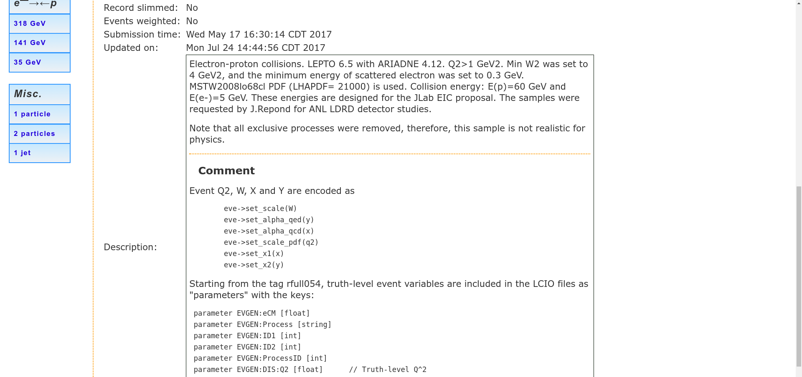
Event generator details
Web Interface - Truth Level Navigation

Slide 12
Validation
Web Interface - Truth Level Navigation

Slide 13
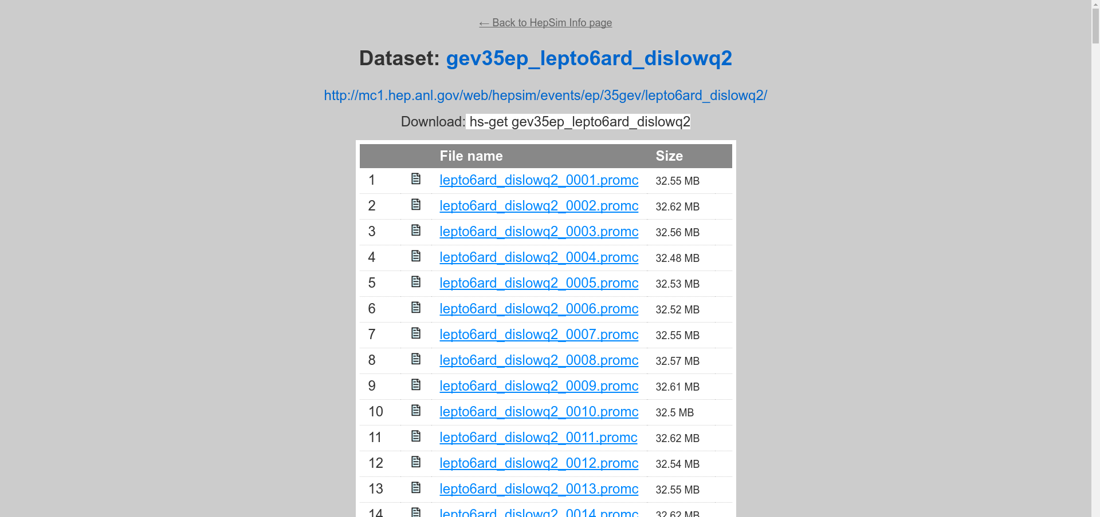
hs-toolkit helper command
Direct HTTP download links
Web Interface - Truth Level Navigation

Slide 14
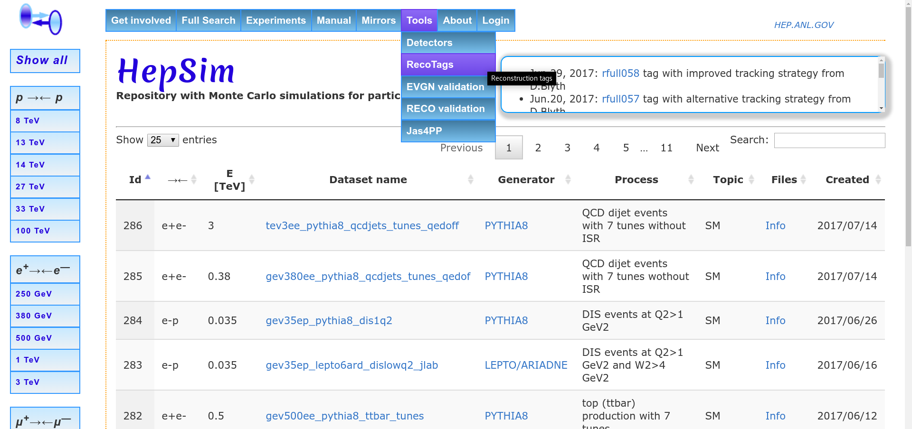
Under tools, click RecoTags
Web Interface - Simulation Tag Navigation

Slide 15
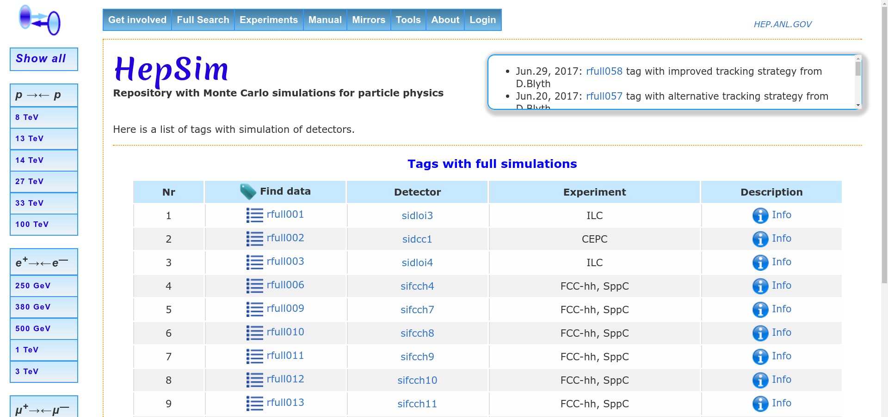
Navigate by detector and/or experiment
Web Interface - Simulation Tag Navigation

Slide 16
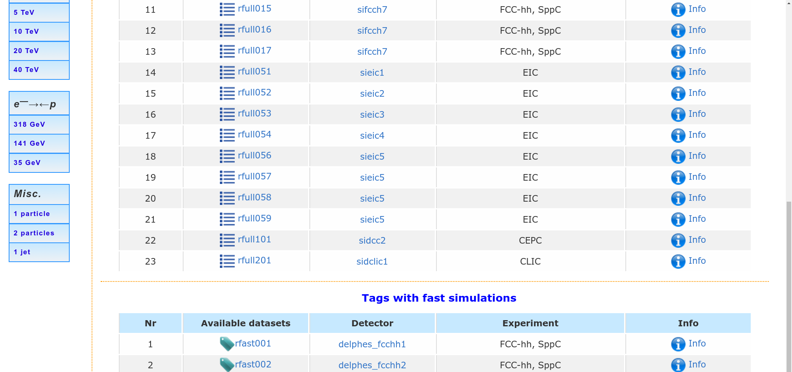
Use Info link to learn more about a tag
Web Interface - Simulation Tag Navigation

Slide 17
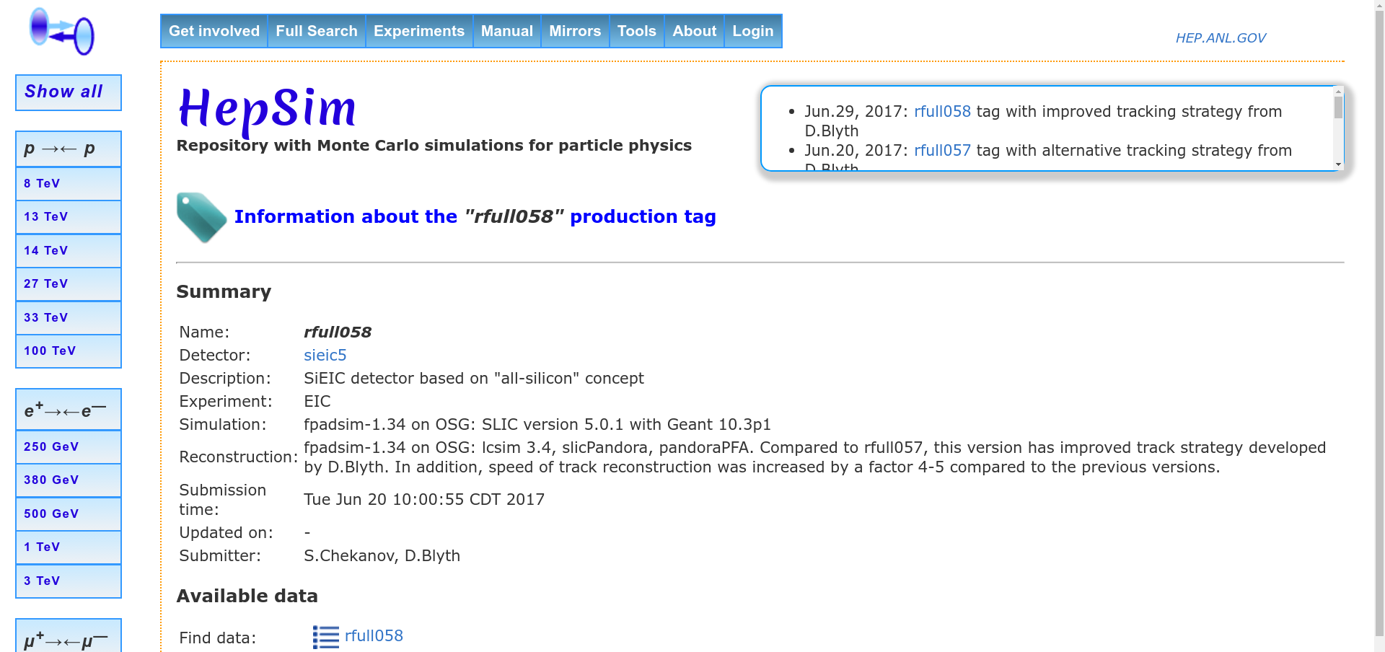
From here, detector information and a list of simulated/reconstructed datasets can be found
Dataset list
Web Interface - Simulation Tag Navigation

Slide 18
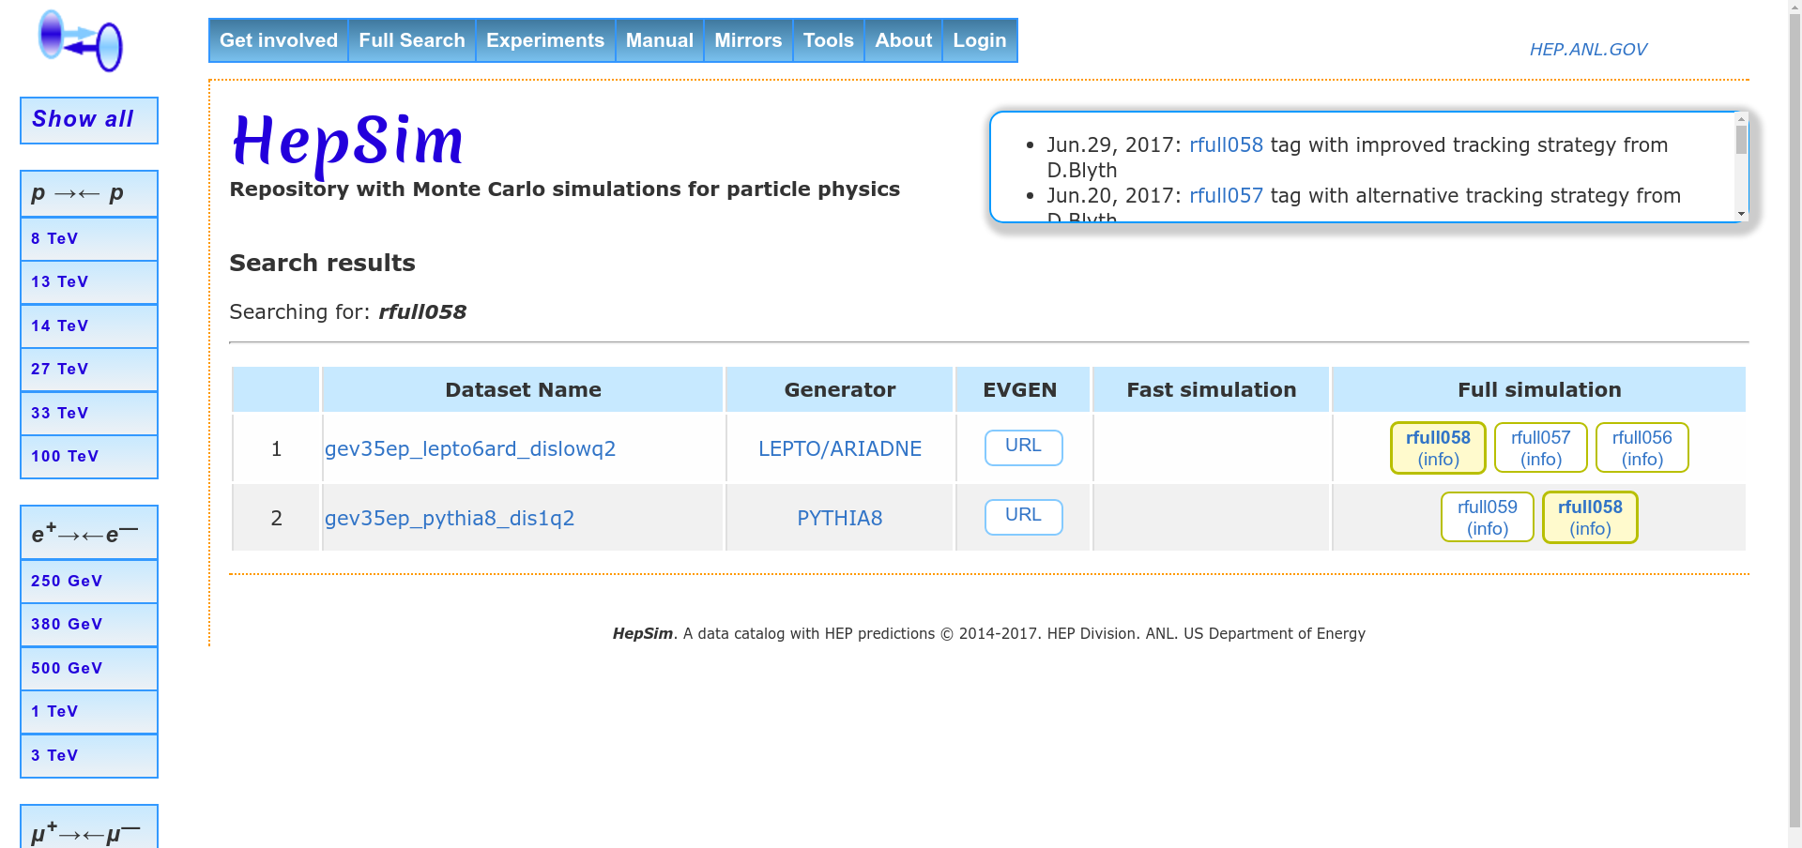
Click on a link highlighted in yellow
Web Interface - Simulation Tag Navigation

Slide 19
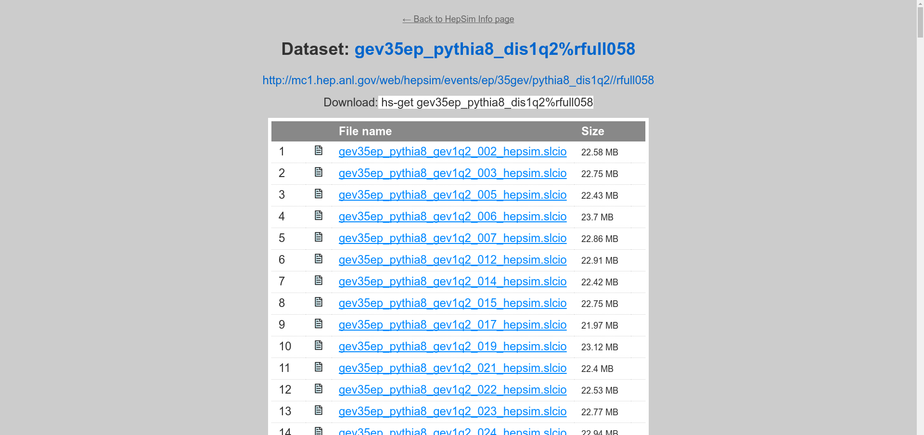
Note that hs-toolkit command is now tagged
Web Interface - Truth Level Navigation

Slide 20
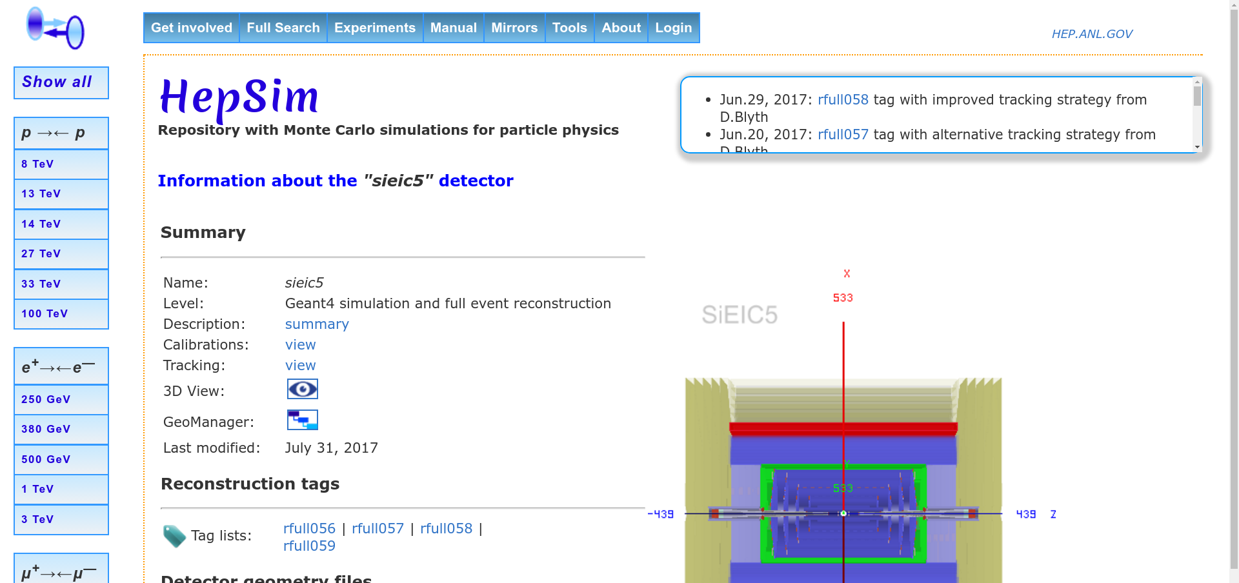
Web Interface - Detector

Slide 21
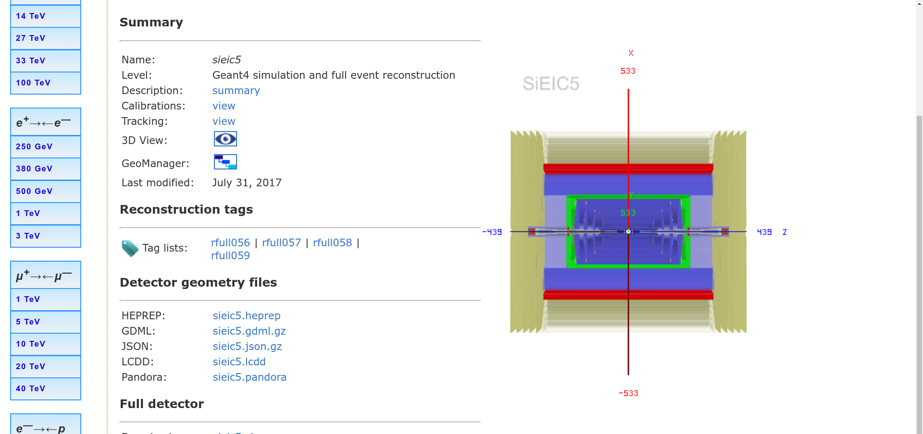
JSROOT Visualization
Geometry in various formats
Web Interface - Detector

Slide 22
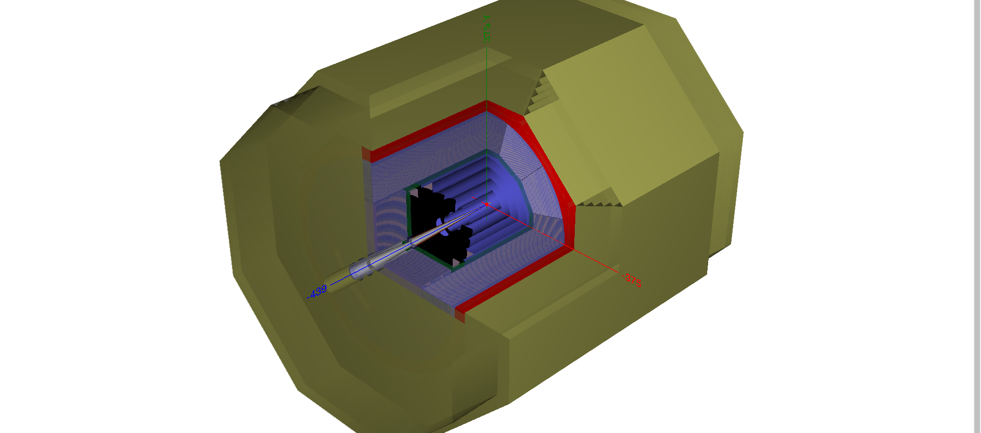
Web Interface - Detector Visualization

Slide 23
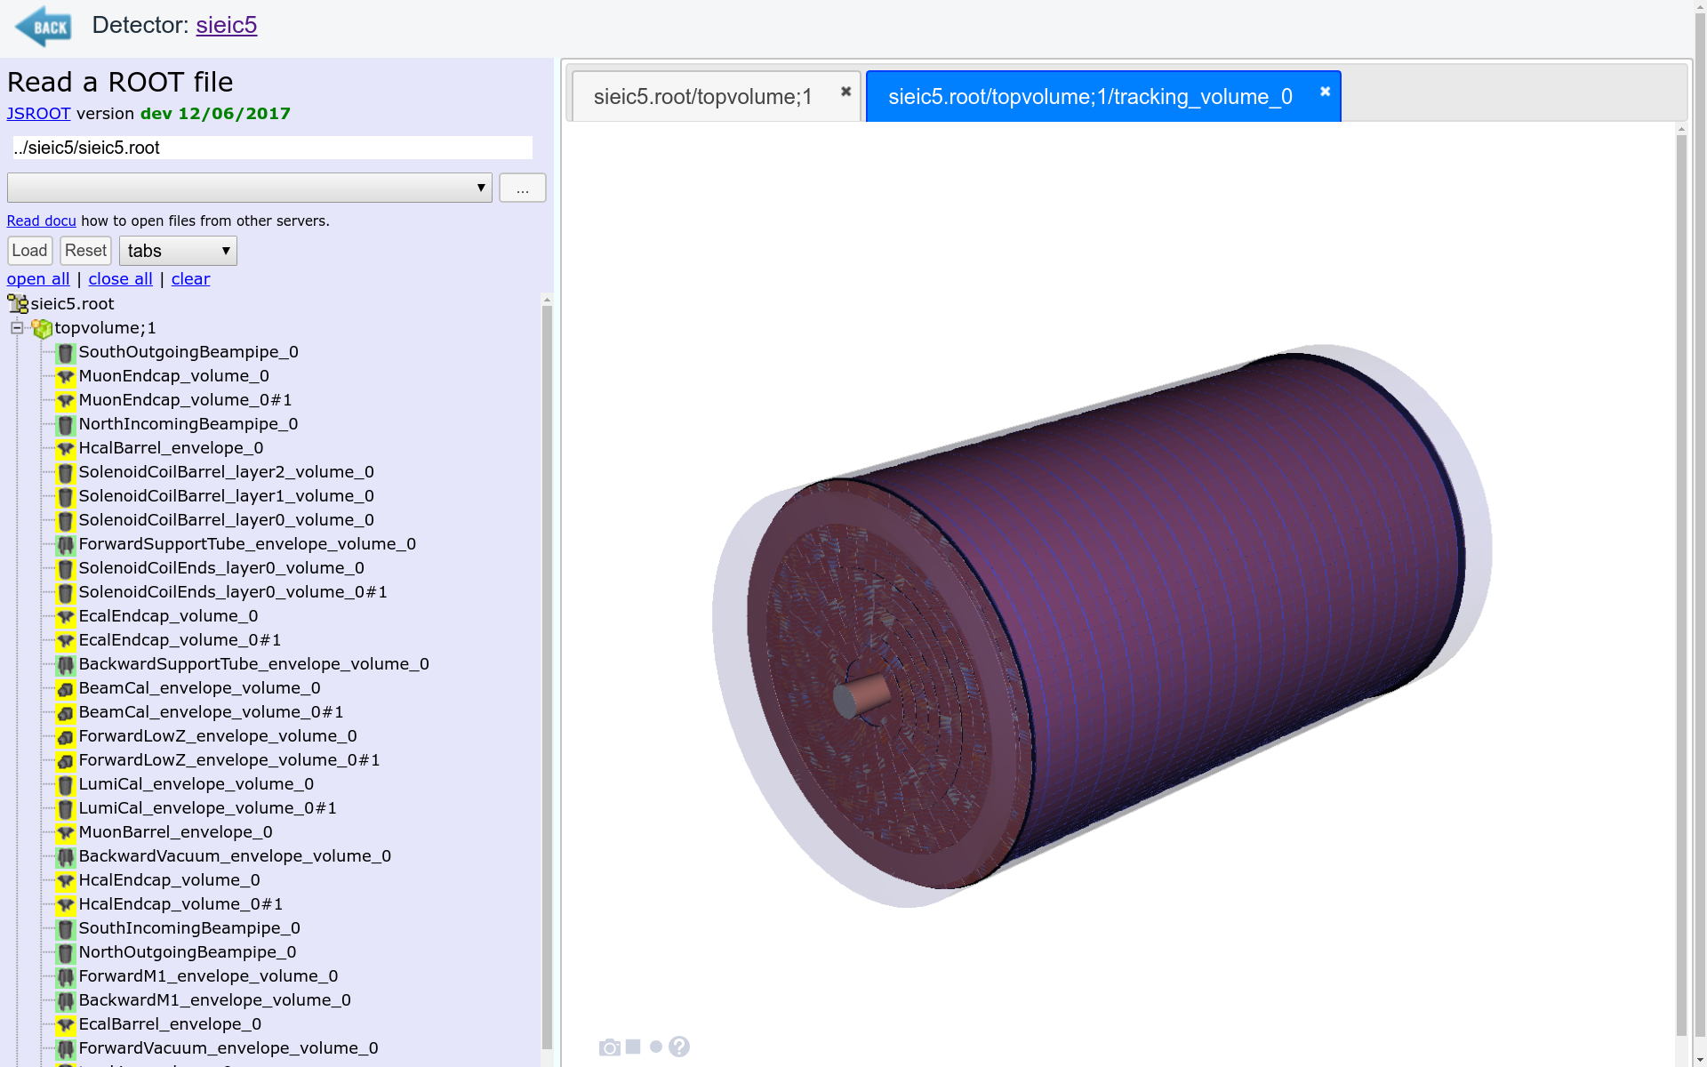
Web Interface - Detector Visualization

Slide 24
hs-toolkit

Slide 25
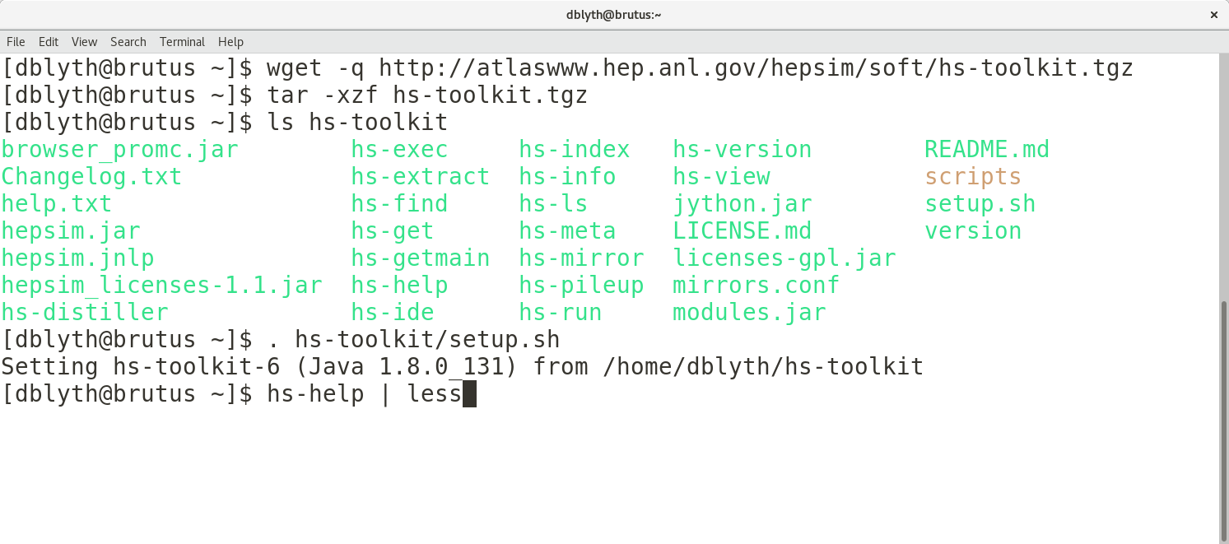
hs-toolkit - Download and setup

Slide 26
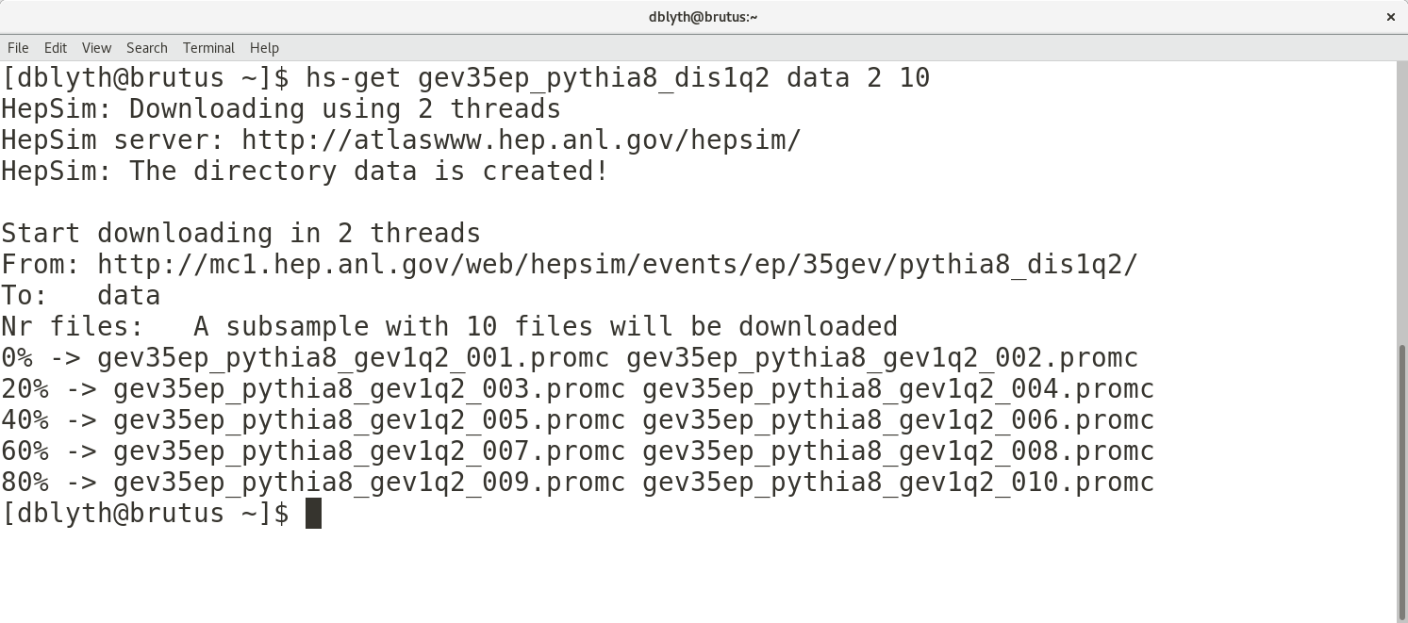
NUM FILES
NAME
OUTPUT DIR
NUM THREADS
hs-toolkit - Get truth-level files with hs-get

Slide 27
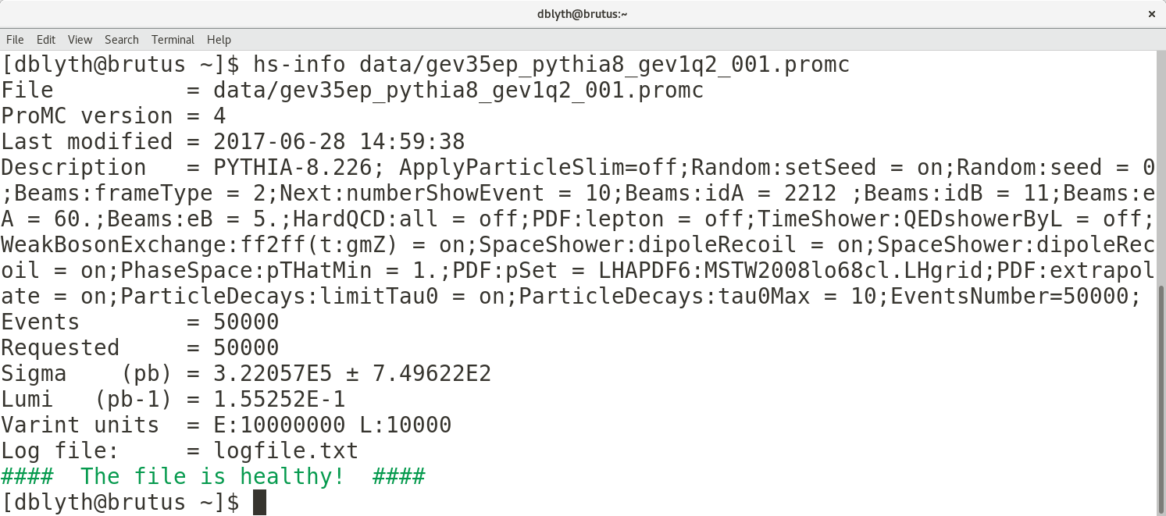
hs-toolkit - Examine truth-level files with hs-info

Slide 28
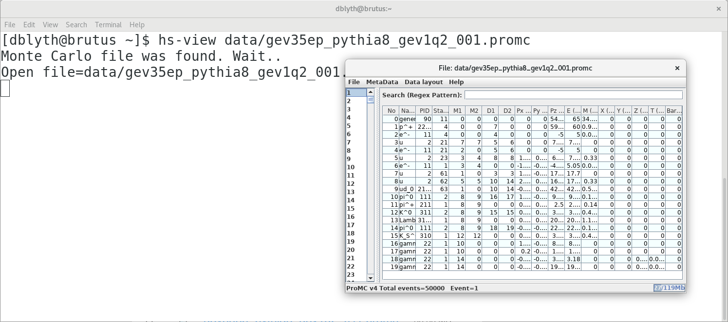
hs-toolkit - Graphically examine truth-level files with hs-view

Slide 29
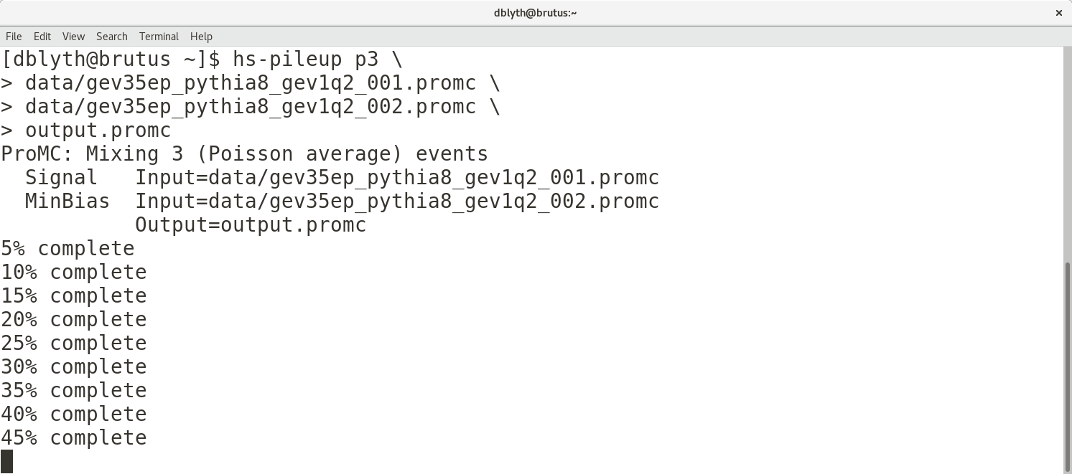
hs-toolkit - Simulate pileup with hs-pileup

Slide 30
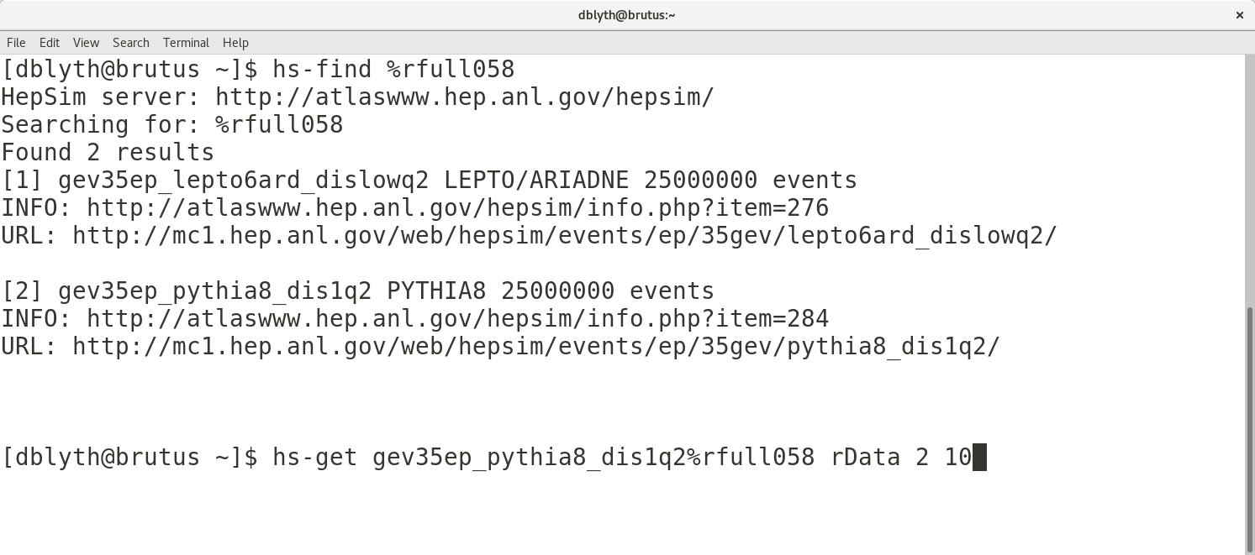
hs-toolkit - Find and get simulation/reconstruction files with hs-find and hs-get

Slide 31
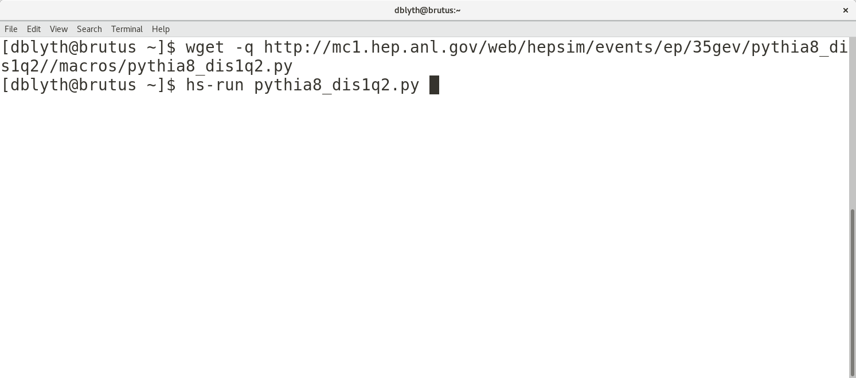
hs-toolkit - Run validation python scripts with hs-run

Slide 32
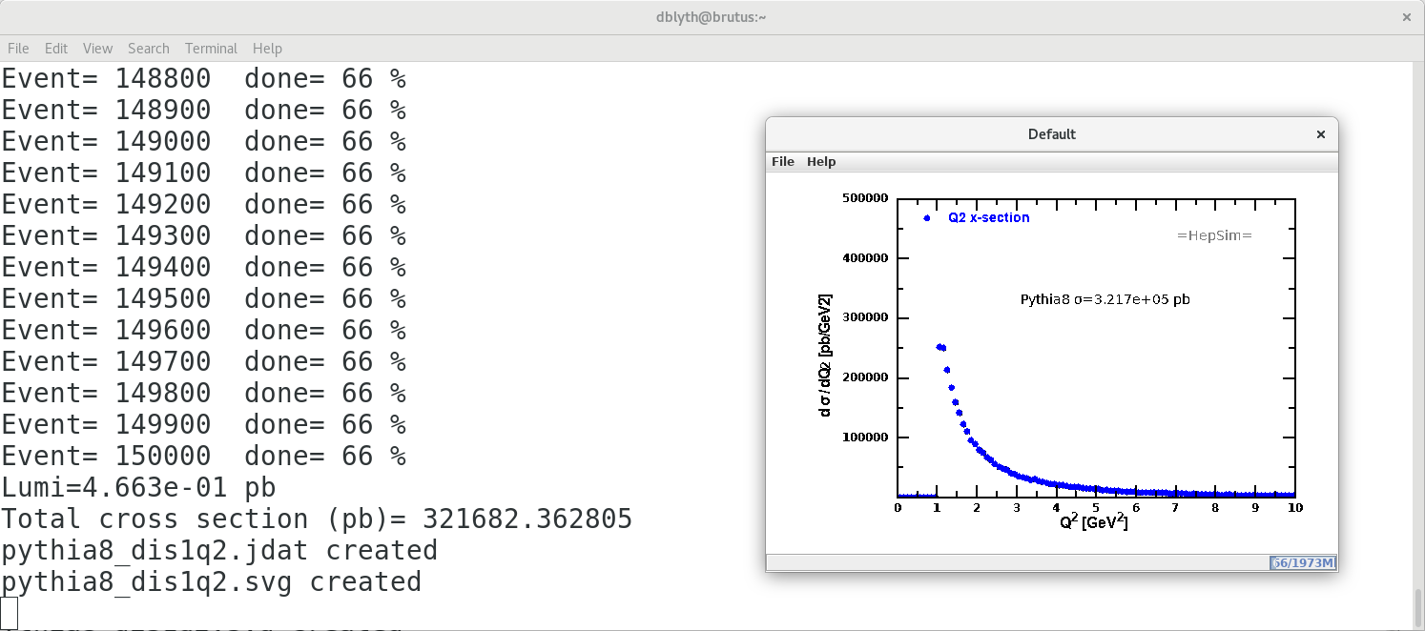
hs-toolkit - Run validation python scripts with hs-run

Slide 33
How my work uses HepSim
EIC experiment design
Development of simulation and reconstruction software chain
Using HepSim’s truth-level samples as input
Produce simulated/reconstructed samples at key points as software chain evolves
HepSim simulation tags serve as a means to distribute and organize samples within research group
Detector geometry iteration
Using HepSim’s truth-level samples as input
Each geometry iteration is documented with simulation tags
Research group collaboratively assesses change in detector performance by referencing tags

Slide 34
Near-future HepSim developments
Better argument handling in hs-toolkit
Associating simulation/reconstruction tags with container image tags
Provide the ability to exactly reproduce tag datasets
Snapshot of all software and parameters that went into producing a tag

Slide 35
Thanks!
For more information, please see the HepSim web manual and hs-help on the command line.
HepSim contributors:
http://atlaswww.hep.anl.gov/hepsim/doc/doku.php?id=hepsim:contributions

